Slide 1
Final Engagement
Attack, Defense & Analysis of a Vulnerable Network
Madison Coldwell, Mani Prabhu, Mansour Tawk, Riley Peters

Slide 2
Table of Contents
This document contains the following resources:
Network Topology & Critical Vulnerabilities
Exploits Used
Avoiding Detection & Maintaining Access

Slide 3

Network Topology
& Critical Vulnerabilities
‹#›

Slide 4
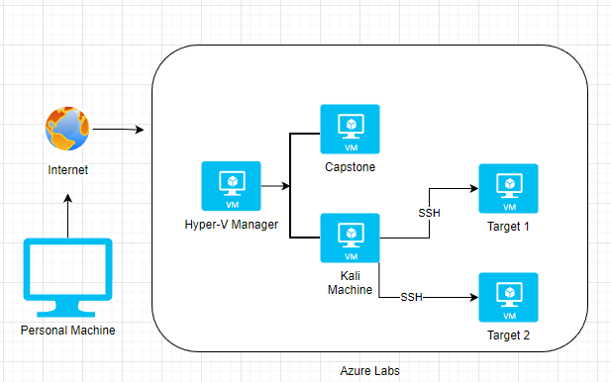
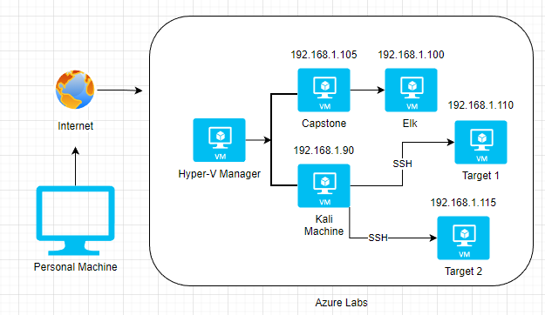
Network Topology
Network
Address Range: 192.168.1.0/24
Netmask: 255.255.255.0
Gateway: 192.168.1.1
Machines
IPv4: 192.168.1.90
OS: Debian Kali 5.4.0 GNU/Linux
Hostname: Kali
IPv4: 192.168.1.110
OS: Debian GNU/Linux
Hostname: Target 1
IPv4: 192.168.1.115
OS: Debian GNU/Linux
Hostname: Target 2
IPv4: 192.168.1.105
OS: Linux Ubuntu 18.04
Hostname: server1
(Capstone)
IPv4: 192.168.1.110
OS: Linux
Hostname: Elk
192.168.1.105
192.168.1.1
192.168.1.110
192.168.1.90
192.168.1.115

Slide 5
Critical Vulnerabilities: Target 1
Our assessment uncovered the following critical vulnerabilities in Target 1.
Vulnerability | Description | Impact
WPscan Enumeration | Wordpress is unconfigured/plugin not added to block wpscan. | Using wpscan, a bad actor could enumerate user information.
SSH Login using passwords | SSH Login possible using weak passwords, instead of using SSH Keys. | Any weak passwords on user accounts are easily brute-forceable
No Password Policy | Without the use of a rigid password policy, users are able to set weak passwords which are crackable in hash format. | Simple and easily guessed passwords allowed access to the target resulting in privilege escalation.
Password stored in plaintext | MySQL password stored in plaintext in the wp-config.php file. | Allowed unauthorised access to mysql database and sensitive information.

Slide 6
Exploits Used
‹#›

Slide 7
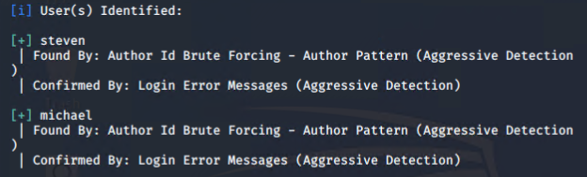
Exploitation: WPscan Enumeration
Wordpress is a widely used tool with a large amount of plugins and services to use within Wordpress. One popular tool for testing the security of Wordpress servers is wpscan. This tool can perform a number of enumeration tasks on vulnerable Wordpress servers, including finding users for the server. This was done with the command:
wpscan --url http://192.168.1.110 --enumerate u
This resulted in the user names of two users being revealed (see fig.1) and password cracking could could now commence.
fig.1 - Users enumerated from the target with wpscan.

Slide 8
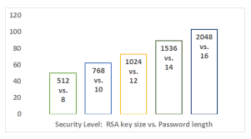
Exploitation: SSH Login using passwords
Brute Force attack technique was used to crack the password for the user Michael (detailed in the next vulnerability). This was only originally possible through the use of SSH passwords to grant login access rather than the use of keys.
Using SSH keys would eliminate the risk of a weak password being brute forced as there is no password to crack. Key encryption and authentication is a much more secure way of using SSH services and is always recommended in the industry over personally set passwords.
source: https://thorntech.com/passwords-vs-ssh/

Slide 9
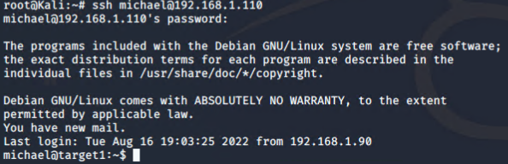
Exploitation: No Password Policy
Using the Hydra tool, it was possible to brute-force the password for the user account of michael (see fig.2). This is because this user made their password the same as their name, thus making it extremely weak. A rigid password policy would prevent this occurring.
Using this method granted access to the target 1 machine (see fig.1)
fig.1 - Access gained to target 1 machine via user account for michael

Slide 10
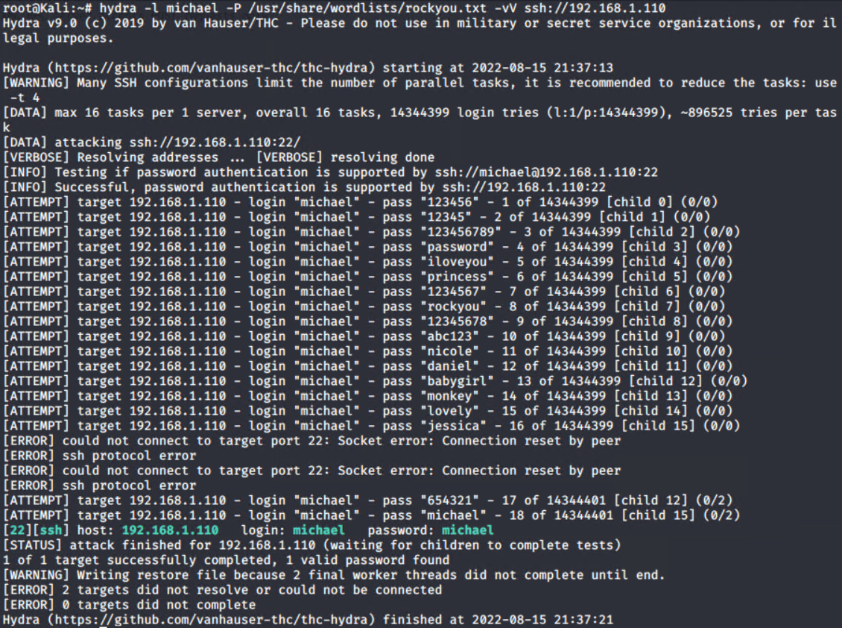
Exploitation: No Password Policy
fig.2 - Hydra command (top) used to brute force the user account of michael

Slide 11
Exploitation: Password stored in plain text
After accessing the path /var/www/html, a directory called Wordpress was found which contains all of the configuration files for the Wordpress application.
Inside this folder, the file wp-config.php could be accessed. Inside was the name and login information for the applications MySQL databases (see fig.1 on next slide).
The password for the user was stored without encryption, in plaintext, allowing an easy login to MySQL and availability to subsequent databases and sensitive information.
Ultimately, the impact of this vulnerability meant that the password hash for the user steven was discovered (see fig.2 and fig.3 on next slide), which led to the root user being compromised, detailed in the upcoming slides.

Slide 12
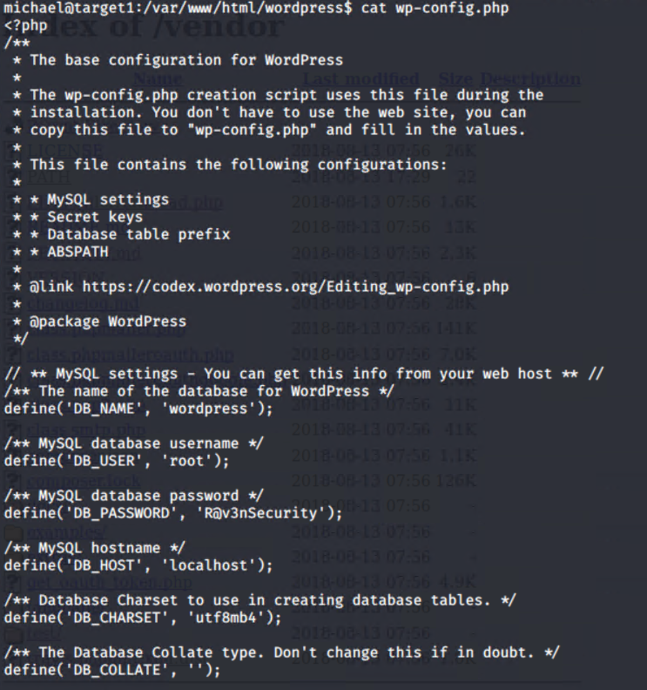
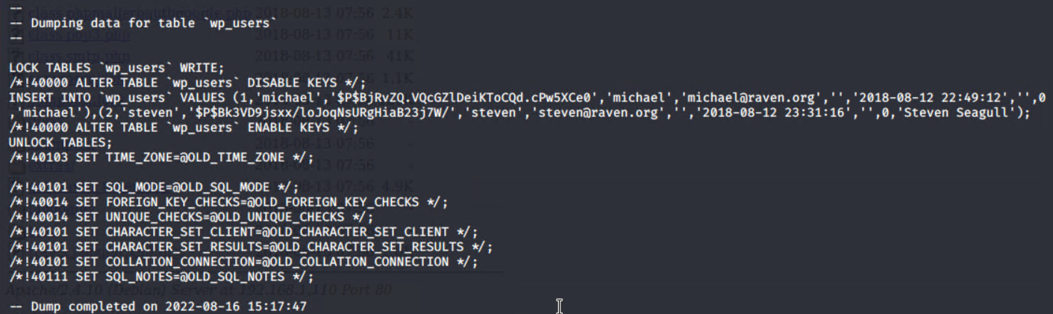
Exploitation: Password stored in plain text
fig.2 - Once the password was known, the tool mysqldump was used to dump the contents of the database called ‘wordpress’
fig.3 - The data from the dump revealed a table called ‘wp_users’ which contained the password hash data related to both michael and steven’s user accounts
fig.1 - the contents of wp-config.php. The password found was R@v3nSecurity for the root user in MySQL

Slide 13
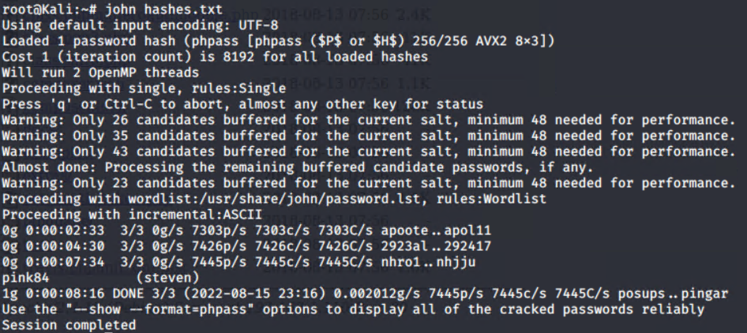
Exploitation: Password stored in plain text
The impact of this exploit in turn reached further than just gaining the user steven’s password hash. From this, the hash was able to be cracked with a tool known as John the Ripper (see fig.4) after the values were copied over to a file called hashes.txt.
Once Steven’s password was compromised, it was possible to log in to his account through SSH and then check his sudo permissions with the command sudo -l. This revealed Steven could use the python library (see fig.5).
From here, a known python exploit was used to attain a root shell from Stevens user account, exposing sensitive data (see fig.6).
fig.4 - Using the John tool to crack the password hash. Resulting in the password for stevens account: pink84

Slide 14
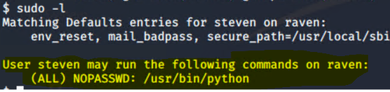
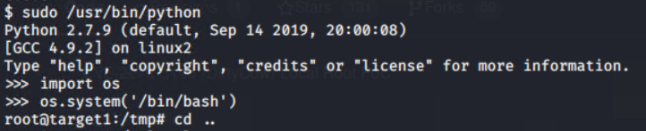
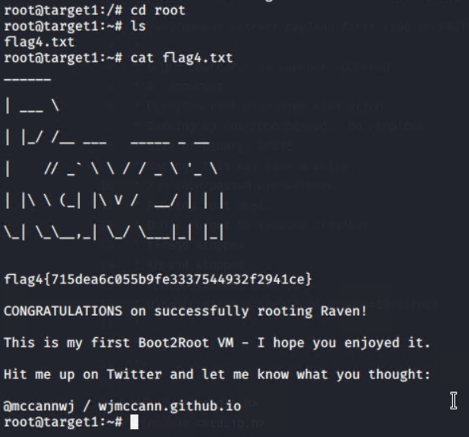
Exploitation: Password stored in plain text
fig.5 - Once logged in as steven, the command sudo -l revealed his permission to use the Python library (highlighted).
fig.6 - Python exploit to gain a root shell. Attacker was located in the /tmp folder. From here, sensitive data in the root directory above could be accessed.
fig.6.1 - Sensitive data discovered - flag4.txt containing the following flag: {715dea6c055b9fe3337544932f2941ce}

Slide 15
Avoiding Detection
‹#›

Slide 16
Stealth Exploitation of WPscan Enumeration
Monitoring Overview
To detect any activity originating from wpscan, we can query live data for the user agent associated with the tool and block it out with the following:
query: user_agent.original : *WPscan* AND destination.ip: 192.168.1.110
The metrics being measured:
user_agent.original and destination.ip
For the alert to be successful, a threshold of one is acceptable as any traffic detected from this user agent should be blocked straight away and trigger the alarm. The trigger should enable an email and onscreen alert, along with logging of the incident.
Mitigating Detection
To get around this alert, the wpscan options --random-user-agent or --stealthy can be used to ensure that all traffic sent from wpscan originates from a random user agent instead of the default, and also to avoid detection.
An example of a wpscan that would circumvent this alert:
wpscan --url 192.168.1.110 --random-user-agent --enumerate u

Slide 17
Stealth Exploitation of SSH Login using passwords
Monitoring Overview
To detect SSH login attempts, the following Kibana query/filter matched with an alert should be implemented on the dashboard:
query: destination.ip : 192.168.1.110 AND destination.port : 22 AND source.ip : *
The metrics being measured:
destination.ip and destination.port and source.ip
For the alert to be successful, a threshold of 20 over an interval of 5 seconds is appropriate to detect SSH brute force attempts from most brute force tools. Once detected, the traffic from the source IP attempting the attack will be blocked. The alert should trigger both an onscreen alarm and an email alert, along with detailed logging of the incident.
Mitigating Detection
Detection of this nature can be avoided by restricting the login attempts per minute e.g. using the inbuilt options within Hydra. This slows down the processes and makes them harder to detect, albeit at the cost of speed. The following command is a perfect example of this.
hydra -t<number of tasks> -W<ttw between tasks> -l<username> -P<path to wordlist> ssh://192.168.1.110 -vV

Slide 18
Stealth Exploitation of No Password Policy
Monitoring Overview
To detect possible exploitation of weak passwords, it is safe to assume a brute force attack is in play. In this scenario, an alert watching the below query would detect any brute force attempts from the Hydra tool, and block it out.
query: user_agent.original : “Mozilla/4.0 (Hydra)” AND destination.ip : 192.168.1.110 AND destination.port : 80,22
The metrics being measured:
user_agent.original, destination.ip and destination.port
For this scenario, any traffic detected should be blocked at any time. No interval is needed in this scenario, similar to monitoring for wpscan. The alert should trigger both an onscreen and email alert, as well as logging of the event. Ideally in a real world scenario, weak passwords should never be acceptable, and a rigid password policy would help mitigate the obvious risk, not just monitor and block as it is happening.
Mitigating Detection
Using an alternative method to attempt the brute force attack such as guessing or using other brute force tools such as Patator and Crowbar. Alternatively, cracking password hashes could be done with such tools as John the Ripper or hashcat.

Slide 19
Maintaining Access
‹#›

Slide 20
Maintaining Access
When it comes to maintaining access to the machine, it was important to implement some form of persistence so that the target machine could easily be accessed at a later time. While using a malicious payload or bind shell method of persistence would most likely be possible and powerful, it was unnecessary.
In this scenario, persistence can easily be obtained by two simple methods, adding a secret user, or simply dropping SSH keys from the root user.
Both methods are detailed in the following slides, resulting in two different forms of SSH persistence with the target.

Slide 21
Maintaining Access: Useradd & Usermod
Once root access was obtained through the use of a Python exploit, it was possible to use this access to create new users on the system using the useradd & usermod command, as well as set their passwords using the passwd command (see fig.1 and fig.2 on the next slide).
Doing this ensured that SSH connection could be re-established at a later time using credentials set by the attacker. In this case, the user backdoor was created with a generic password, but in a realistic setting this username would need to be more inconspicuous so as to not raise suspicion from system administrators, as well as making the id for the user under 1000 to appear as a service account.
Then, the usermod command was again utilised to add user backdoor to the sudo group, allowing them to perform any command on the system using the sudo command (see fig.3 on the next slide).
While this method of persistence works, in a real setting it most likely would set off potential alarms or alerts due to user modification typically being reserved for administrators.

Slide 22
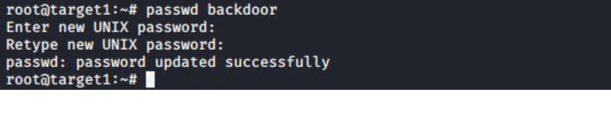
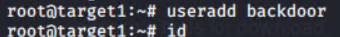
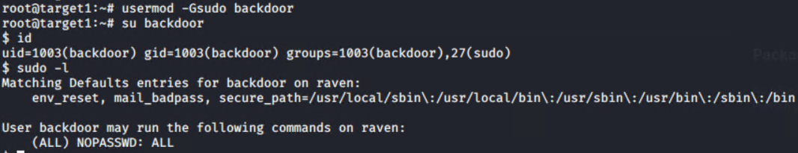
Maintaining Access: Usermod
fig.1 - Adding the user backdoor.
fig.2 - Setting the password for the new user backdoor successfully.
fig.3 - Adding the user backdoor to the sudoers group, then switching to said user to list his sudo permissions with sudo -l to show he may run all commands on the system using sudo.

Slide 23
Maintaining Access: SSH Key Drop
Once root access was obtained through the use of a Python exploit, it was also possible to perform an SSH key drop to our local host machine. This is done simply by generating an SSH key while logged in as root on the target inside the root user’s /.ssh folder (see fig.1 on the next slide).
This public version of this key was then added to a file created called authorized_keys, a file SSH can use to reference allowed keys for login. Before logging out, the associated private key was printed to the terminal and copied to the clipboard (see fig.2 on the next slide).
Back on the host machine, it was a matter of creating an id_rsa file (used to hold SSH keys) and paste the contents of the clipboard there (being the private key from the root user). After a quick permissions change, the id_rsa file is now ready to be used to log back into the root user on the target at any time, as long as it’s from this machine (see fig.3 on the next slide).

Slide 24
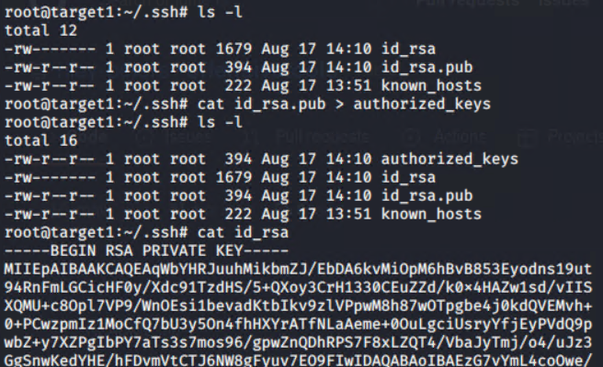
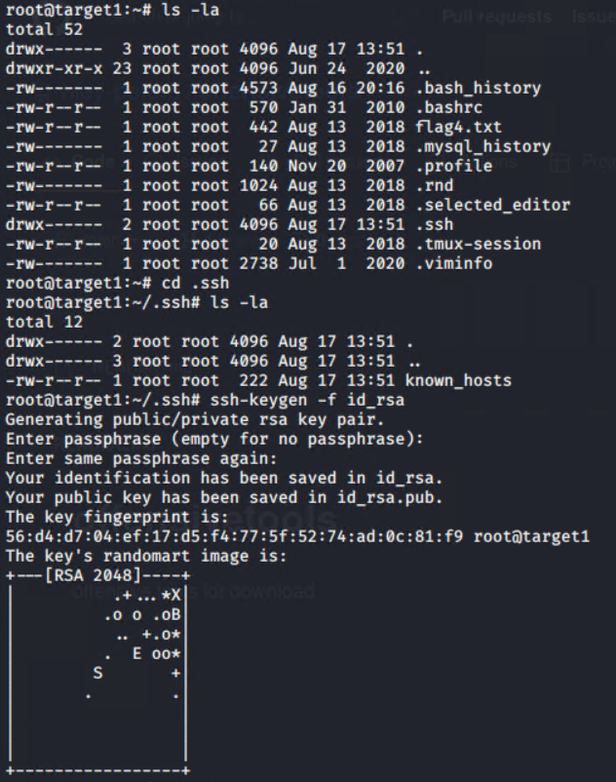
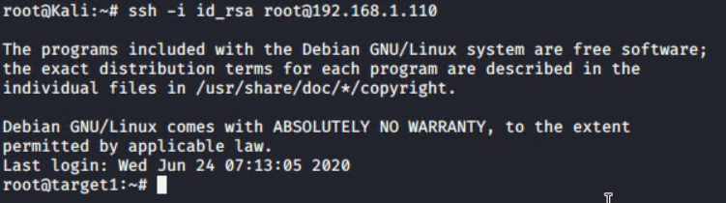
Maintaining Access: SSH Key Drop
fig.2 - Adding root user public key to the authorized_keys file, then printing the contents of the root user private key to copy to clipboard. This copy was then remade into a key file on the host machine.
fig.1 - Generating SSH key pair inside root user’s /.ssh folder.
fig.3 - Using the new private key created on the host machine, SSH persistence is now in effect. Ensures accessibility to the root user at any time through the attacking machine.

